Slide 1
CONNECTICUT STATE GRANGE
POMONA REDISTRICTING
July 9, 2017

Slide 2
VALUES
COMMUNITY
CHARITY
CITIZENSHIP
HONOR
INTEGRITY

Slide 3
Where do we start?

Slide 4
New Jurisdictions

Slide 5
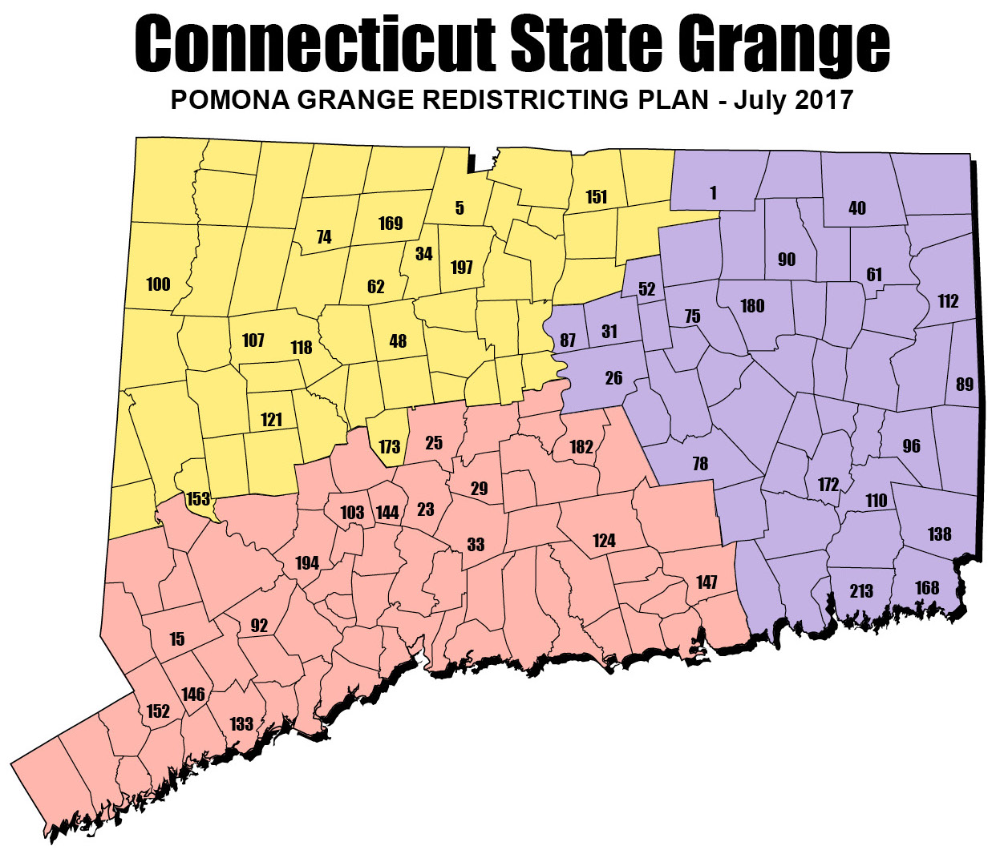
New Jurisdictions
Pomona A
5 Granby
34 Cawasa
48 Whigville
62 Eureka
74 Winchester
100 Taghannuck
107 Litchfield
118 Beacon
121 Bethlehem
151 Enfield
153 Bridgwater
169 Riverton
173 Wolcott
197 Simsbury
A

Slide 6
New Jurisdictions
Pomona B
15 Redding
23 Cheshire
25 Southington
29 Meriden
33 Wallingford
92 Harmony
103 Beacon Valley
124 Higganum
133 Greenfield Hill
144 Prospect
146 Norfield
147 Lyme
152 Cannon
182 Hemlock
194 Oxford
B

Slide 7
New Jurisdictions
Pomona C
1 Stafford
26 Glastonbury
31 Manchester
40 Senexet
52 Vernon
75 Coventry
78 Colchester
87 Hillstown
89 Ekonk Community
90 Ashford
96 Pachaug
110 Preston City
112 Killingly
138 North Stonington Community
168 Stonington
172 Norwich
180 Echo
213 Groton Community
C

Slide 8
HOW?
Mentors have been assigned to each Pomona by the State Grange Executive Committee:
Pomona A Pomona B Pomona C
Ruel Miller Noel Miller George Russell
Jody Cameron Jeff Barnes Bob Sendewicz
Gordon Gibson Todd Gelineau Phil Prelli

Slide 9
The Steps to be taken
Steps Current Pomona's need to do before surrendering Charter
Close out all assets and turn over to State Grange for interim accounting
Cash in all CDs and Savings accounts and deposit money in checking account
Surrender all shares of stocks or bonds (options}
Sell all shares and deposit money received in checking account (will be an expense to broker to sell)
Discuss with State Grange Executive Committee the possibility of transferring the stocks or Bonds to State Grange for an agreed on value and then deposit amount received in checking account
After all assets above transferred to checking account
Ensure all outstanding bills are paid an checks cleared
Pomona Executive Committee audits the books and fill out a final Executive Committee Report,
Once Audit complete, Send check for full amount of the checking account to State Grange Secretary accompanied by the signed Executive Committee Report

Slide 10
The Steps to be taken
Once notified that the check is received and deposited in “State Grange Holding Fund” account close out checking account.
Turn over all regalia, scarves, implements and Pomona Manuals to State Grange Headquarters with a list of transferred properties
Decide on a Subordinate Grange to act as a Custodian Grange for other Pomona owned property. A list of stored property should be sent to State Office.
Notify State Master that all above completed and turn in Charter (must be completed by 10/31/2017)

Slide 11
Steps needed to establish the New Pomona
Steps needed to establish the New Pomona
Mentors will be assigned to each New Pomona by the State Grange Executive Committee
Each Subordinate Grange will provide a list of their Pomona Members to the State Grange including mailing address
Mentors will call a meeting of the Pomona Members of the Subordinate Granges located in the New Pomona’s jurisdiction
At the meeting the following will be addressed
Appoint acting Secretary to take notes
Method of drafting By-Laws (i.e. setting up committee or delegates from each Subordinate Grange)
Suggested Names for each Pomona (to be voted on at Organization Meeting)
Establish date of Organization Meeting
State Grange organize regalia etal for each new Pomona
By Law working group prepares Draft By-Laws

Slide 12
Steps needed to establish the New Pomona
Organization Meeting
Called to order by mentor
Following shall be order of business
Appoint acting Secretary to take minutes of meeting
Report of By-Law Committee or Representative
Adopt By-Laws
Determine procedure for election of Officers and appoint necessary officers for elections
Election of Officer (handled by Mentor)
Vote on New Pomona Name
Install Officers
Any other business
Adopt minutes
Close

Slide 13
Steps needed to establish the New Pomona
Mentors work with State Master to complete all the necessary paperwork to organize the new Pomonas and submit to National
New Pomona Granges
Set up new corporation with the Secretary of State
Set up new non-profit and receive new taxpayer id number from IRS
Establish new bank accounts for transfer of funds from “State Grange Holding Funds”
All necessary costs for the 3 above items will be paid by State Grange from Pomona’s portion of “State Grange Holding Fund”
State Master presents Charters

Slide 14
Frequently Asked Question:
Q. What will happen with our money?
Your money is YOUR money! 100% of the funds that will be held by the state Grange will go to your new Pomona, as long as there are NO outstanding debts owed by your Pomona.
Example: If all of the Granges in your Pomona are in the new Pomona, the New Pomona will receive 100% of the those funds. If 50% goes into one Pomona and 50% goes into another then your funds will be divided evenly to each Pomona.

Slide 15
Pomona Jurisdictions

